Slide 1
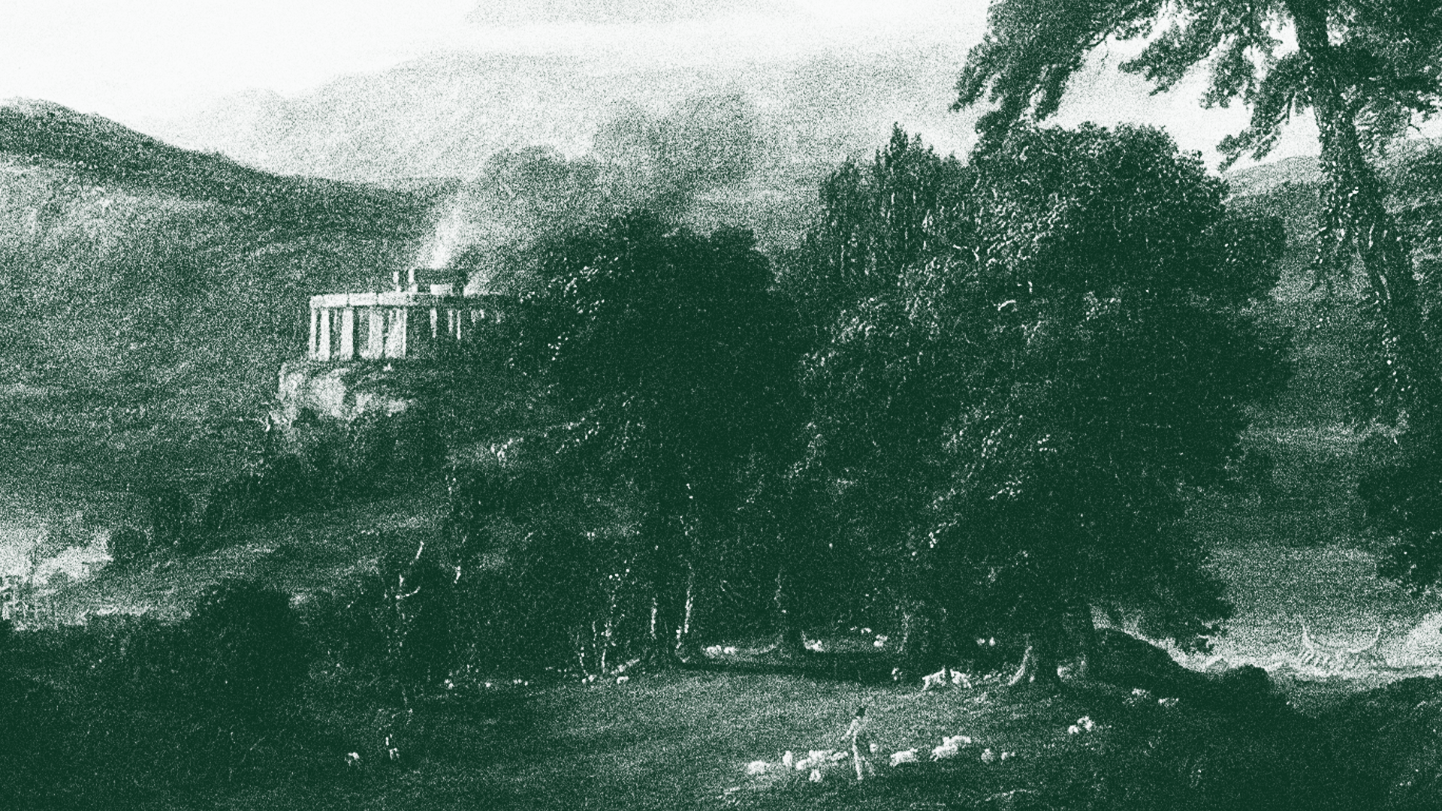

Blog Process Documentation

Slide 2


Purpose
This document will outline the process for selecting images for OneSource blog posts that:
Ensure all blog visuals support OneSource's brand.
Enhance readability, reinforce key messaging, and improve SEO through optimized, high-quality images.
Maintain accessibility and inclusivity in all visual content.
This document is outlined as follows:
Purpose
Image Sourcing & Selection Process
Image Specs & How-To
Shopify Workflow
Shopify Blog Creation Video
Useful Links:
ShutterStock OneSource Brand Guidelines OneSource Content Specs

Slide 3

Image Sourcing & Selection Process
Images are selected via ShutterStock. If a good image can't be found on ShutterStock, or the number of downloads for the month has run out, using free stock sites like Pexels or Unsplash is also acceptable, so long as images are labeled as "Free to use" or something similar.
EX:
ShutterStock Login
Username: jason.looft@winzerusa.com
Password: Winzer4060!

Slide 4
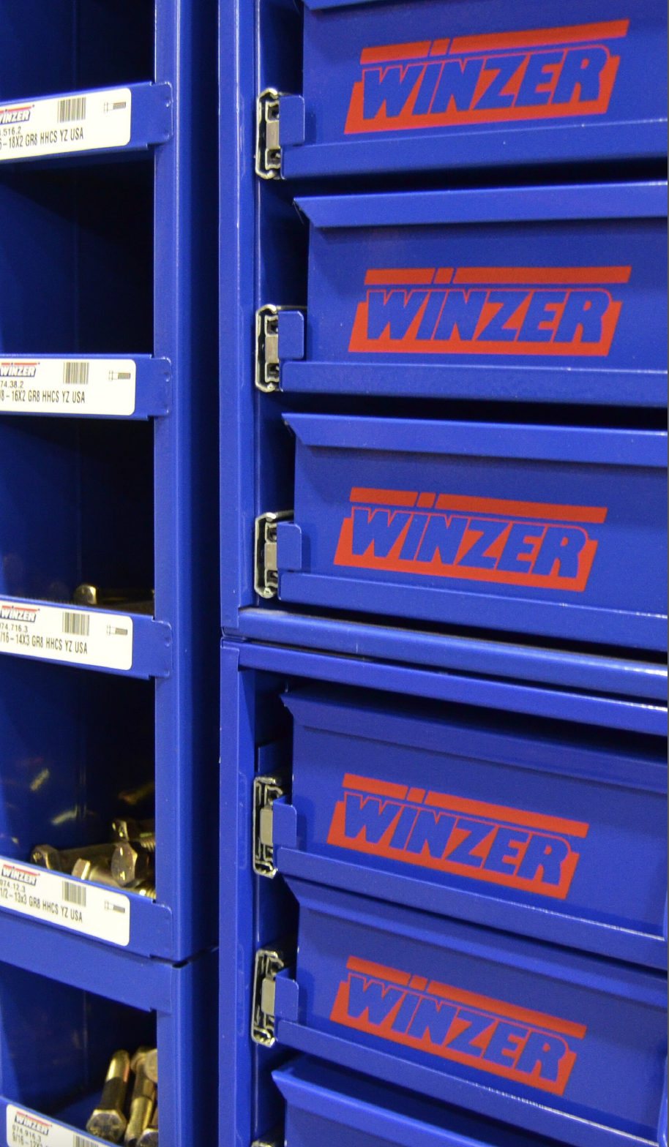
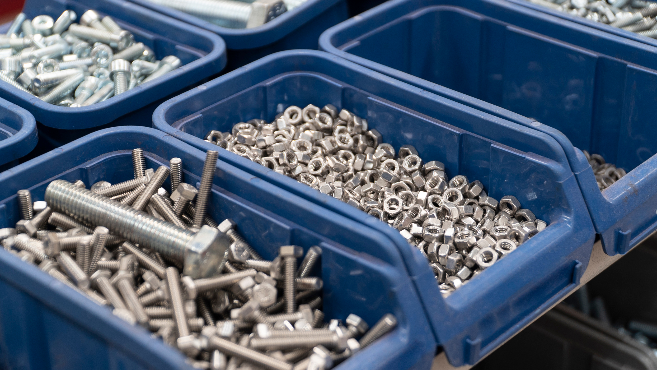

Image Sourcing & Selection Process
When searching for images, the blog title and content is referenced to help narrow the search and identify what to look for. Searches may need to be refined to find the right image Ex: searching "dust mask" vs "man in workshop with dust mask."
When possible, try to find images that relate to items sold in the Winzer group of brands to help reinforce recognition. Also reference brand guidelines when necessary as they outline what to look for in a photograph.
Example: For the "Respirators vs. Dust Masks" blog, the title identified to search for respirators & dust masks. The content identified avoiding breathing sawdust as a use, so a man wearing a mask in a workshop was used.
Example: Winzer sells blue assortment bins. For the "How to Organize Fasteners, Bolts, and Small Parts Like a Pro" blog, the image on the right was used.

Slide 5
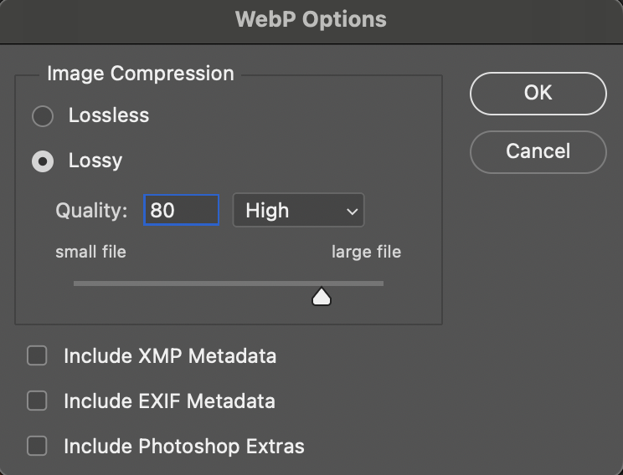
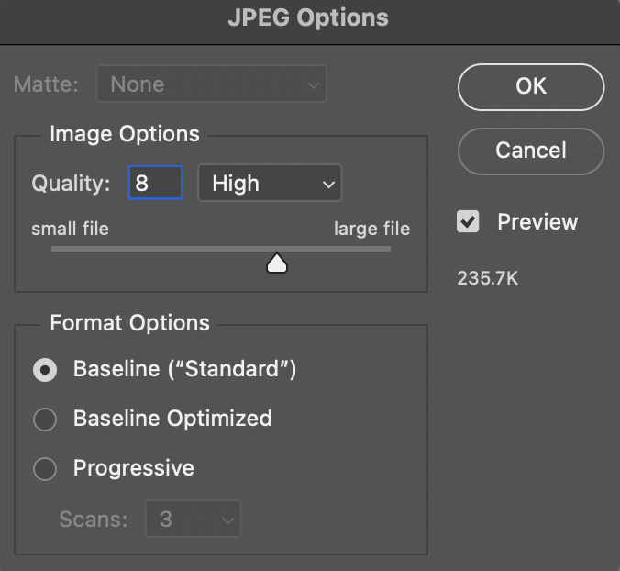
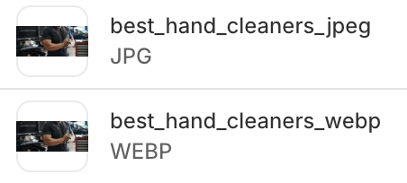
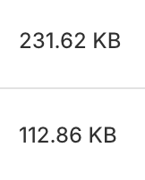
Image Specs & How-To
Image specs can be found in the Content Specs Guide. For blog headers, the spec used is the Large Banner, and should be exported to these formats:
Size: 2400 x 1000px
File Type: WEBP, Lossless, 80% Quality
After downloading an image, it is brought into Photoshop and resized according to spec. After, it is saved as a WEBP file to follow website best practices. If unable to export to WEBP, a JPEG at 80% quality is also acceptable, but it is recommended to then put images into an online WEBP converter. Be mindful of the final file size. Image files should be no larger than 1MB.
File name can be anything but typically saved as the name of the blog post it will be tied to.
Image file size comparison when exported as WEBP vs JPEG

Slide 6
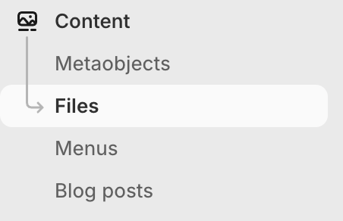
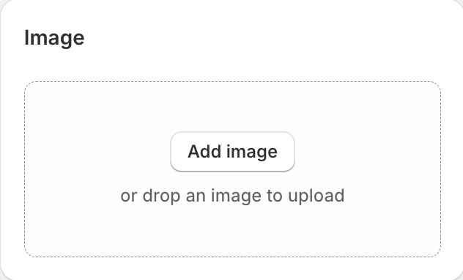
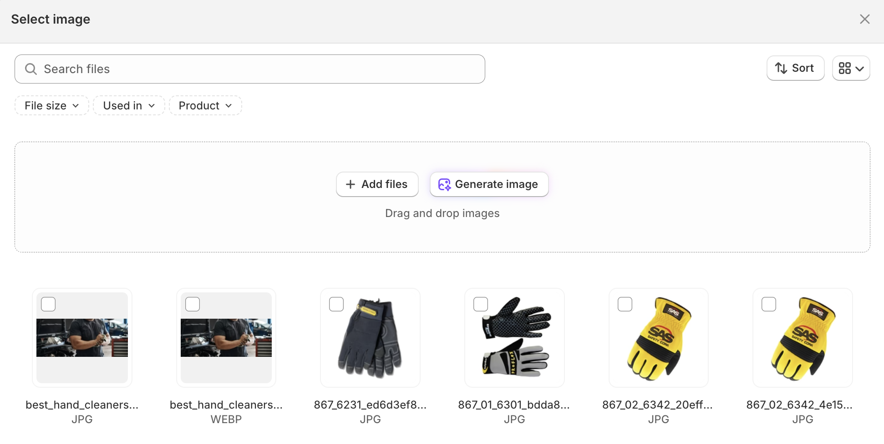
Shopify Workflow
After exporting images to spec, files are then uploaded to Shopify via Content > Files. Images can also be uploaded form the individual blog itself by clicking on the image section and uploading there, or if already uploaded, choose from the assortment.

Slide 7
Shopify Blog Article Creation: Video
This document/video outlines the steps to create, edit, and publish blog articles in Shopify, ensuring proper formatting and SEO practices are followed.
Topics Covered:
Create/Edit Blog Articles in Shopify
Editing Title for SEO Purposes
Article Formatting
Importance of Alt Text in Images
How to Set Visibility Dates for Posts
Importance of Indexing Search Spring for Blog Visibility on Site
Video Link:
Creating Blog Artices in Shopify
Video Chapters:
Creating Blog Articles in Shopify 0:00
Adding Images and Alt Text 3:20
Finalizing and Updating Blog 4:53

Slide 8
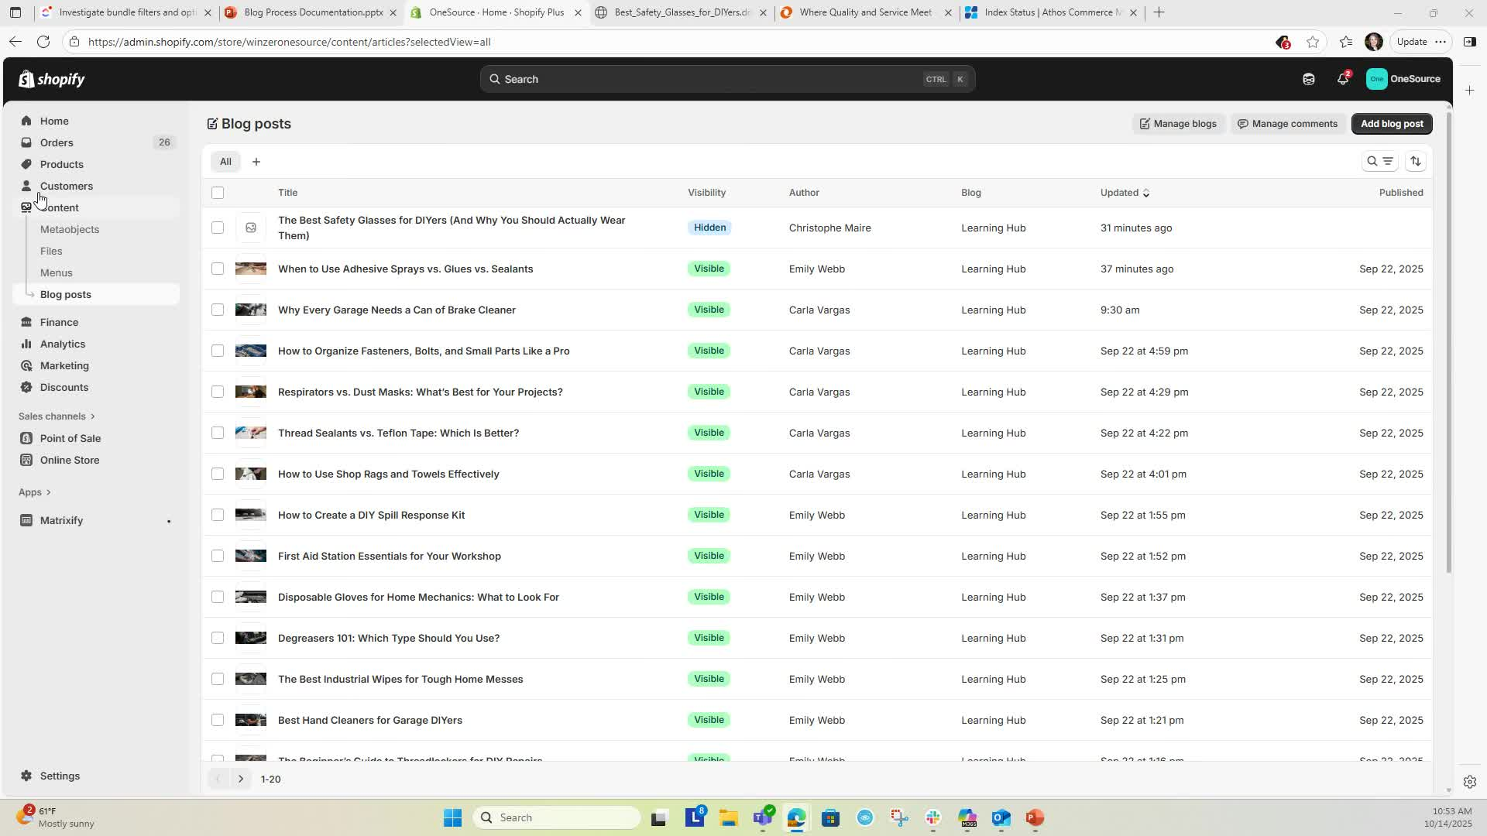
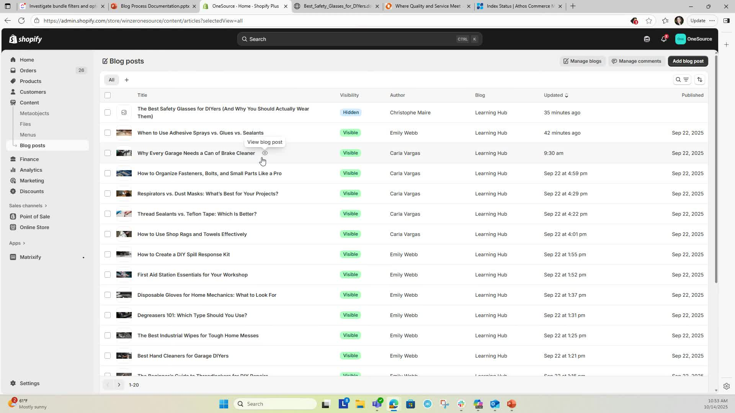
Shopify Blog Article Creation
Log into Shopify platform
Navigate to Content > Blog Posts to create new articles
Click on the blog post you want to edit
Remove any unnecessary words (e.g., "test") from the title to ensure a clean URL
Accessing Blog 0:10
Editing Blog Title and URL 0:19

Slide 9
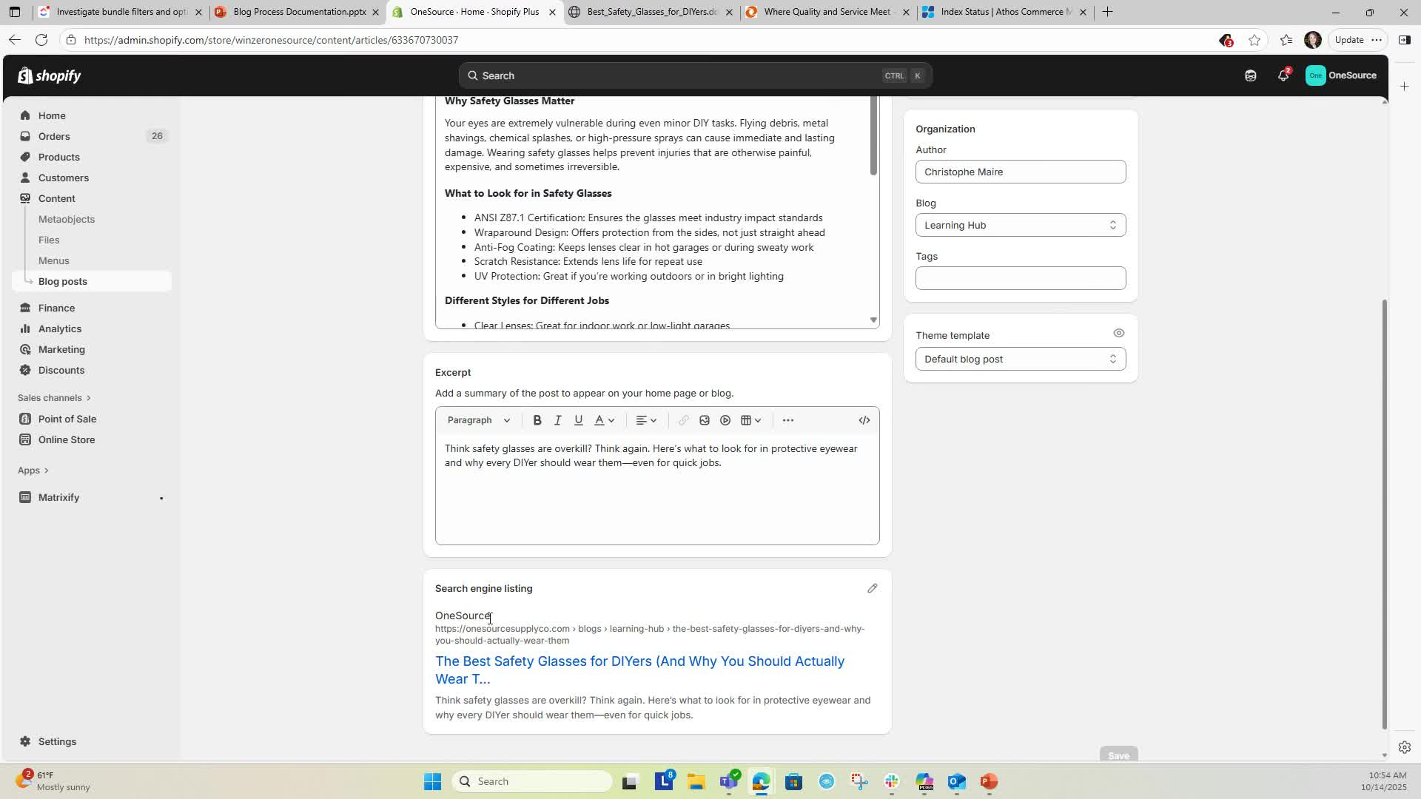
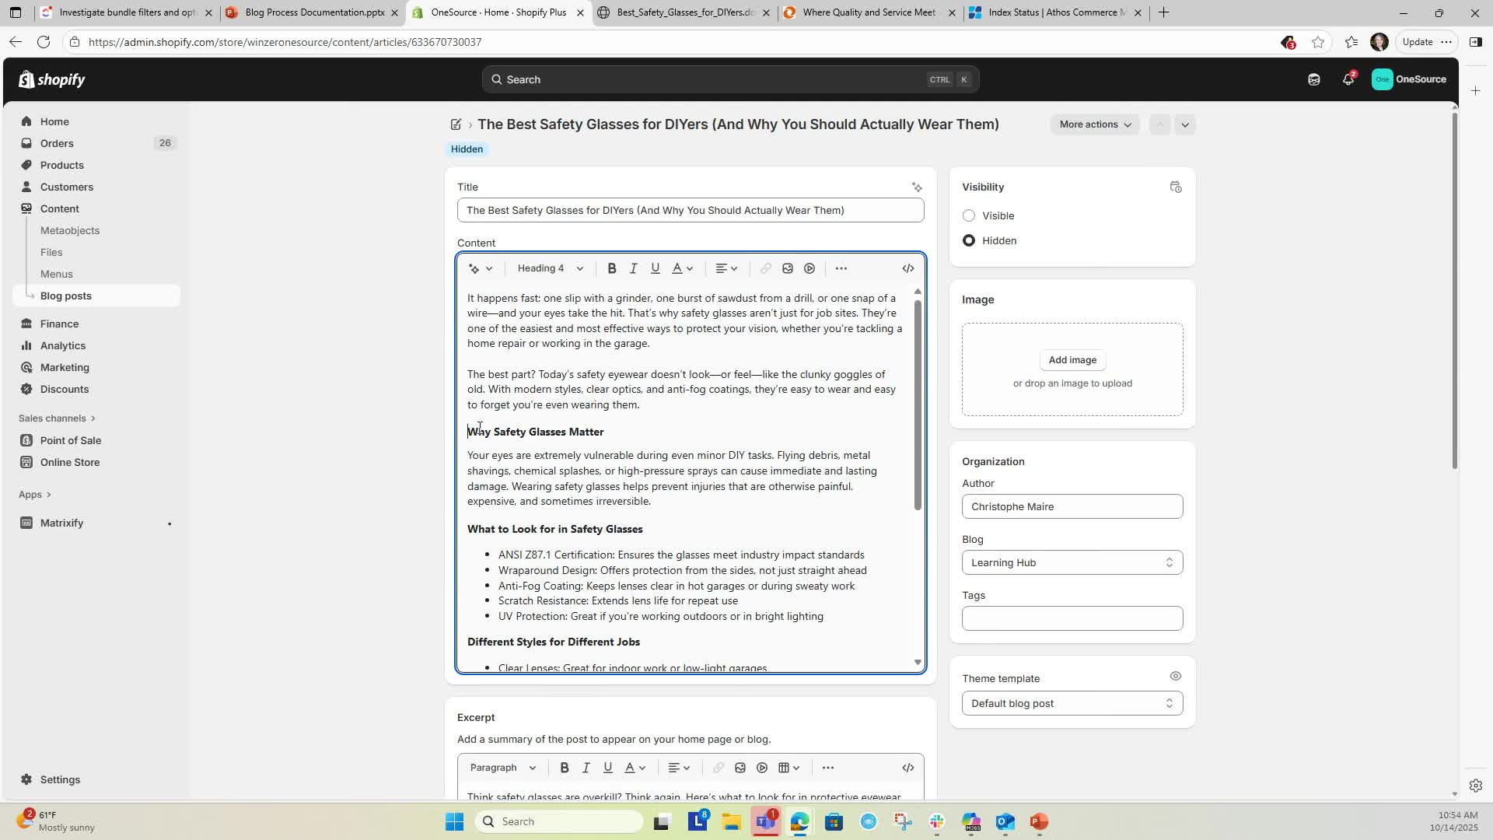
Shopify Blog Article Creation
Updating Search Engine Listing 0:44
Click on Search Engine Listing and then Edit
Remove unnecessary words from the page title and update meta description, then hit Save
Ensure all headings are set to Headline 2 as appropriate
Replace any dashes in the text with bullet points for better readability
Ensure all lines are updated correctly by entering the URL/updating title
Formatting Headings/Body Copy 1:11

Slide 10
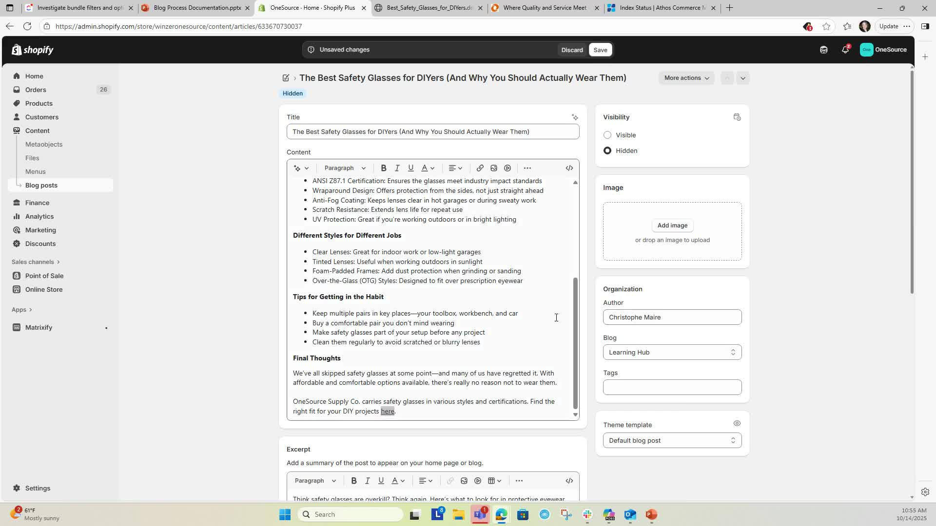
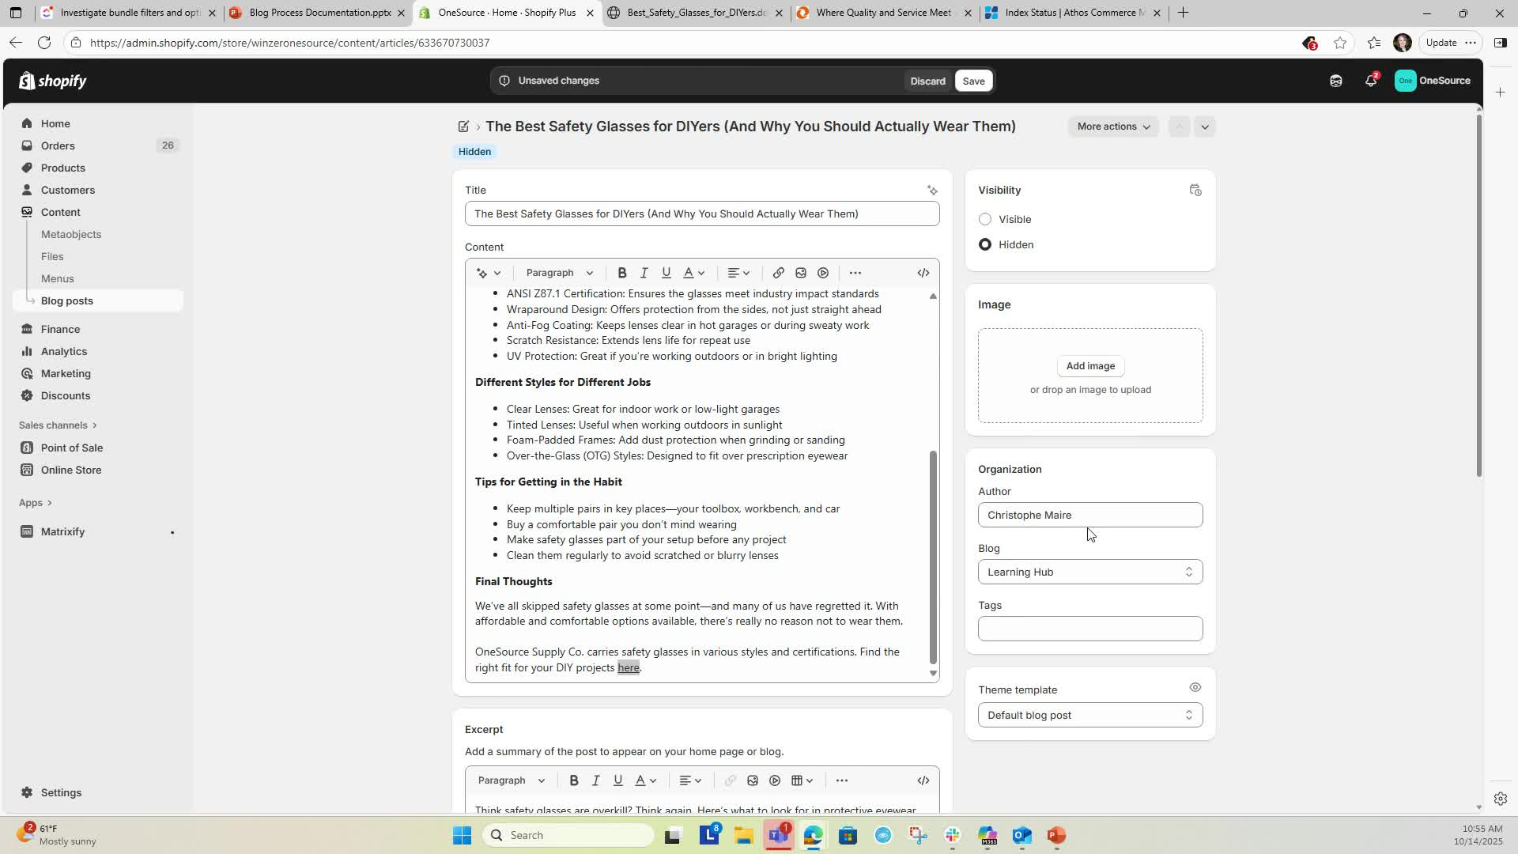
Shopify Blog Article Creation
Setting the Author 2:12
Use your name as the author but note that author names are not currently published on the site. Author is required field
Ensure the blog is set to Learning Hub and the template is set to Default Blog Post
Selecting the Blog and Template 2:34

Slide 11
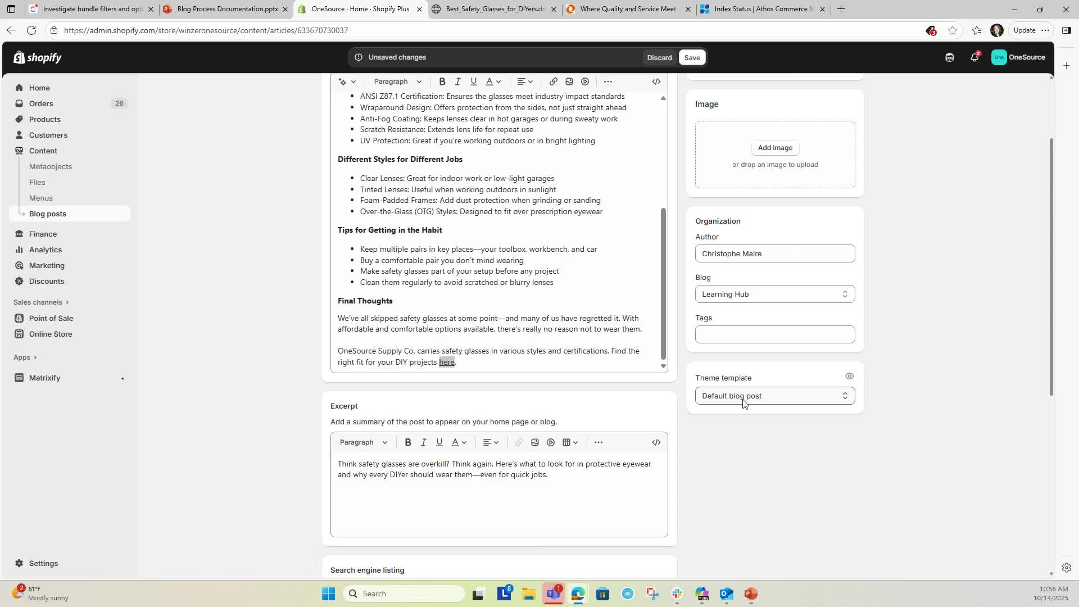
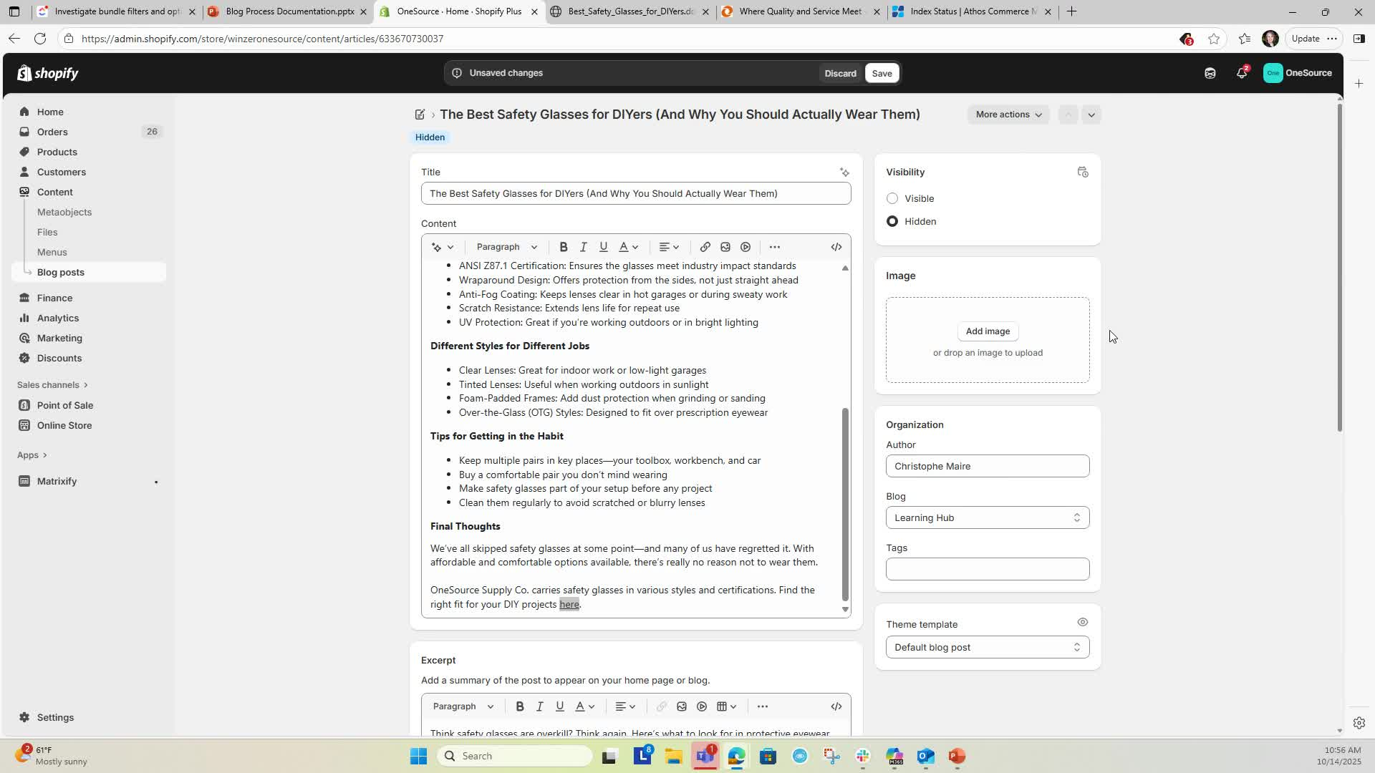
Shopify Blog Article Creation
Writing Excerpts and Meta Descriptions 2:41
Use the excerpt and meta description from the article or AI tools to summarize the content
Click Add Image to select an image for the article
Ensure to include alt text for accessibility
Adding Images 3:00

Slide 12
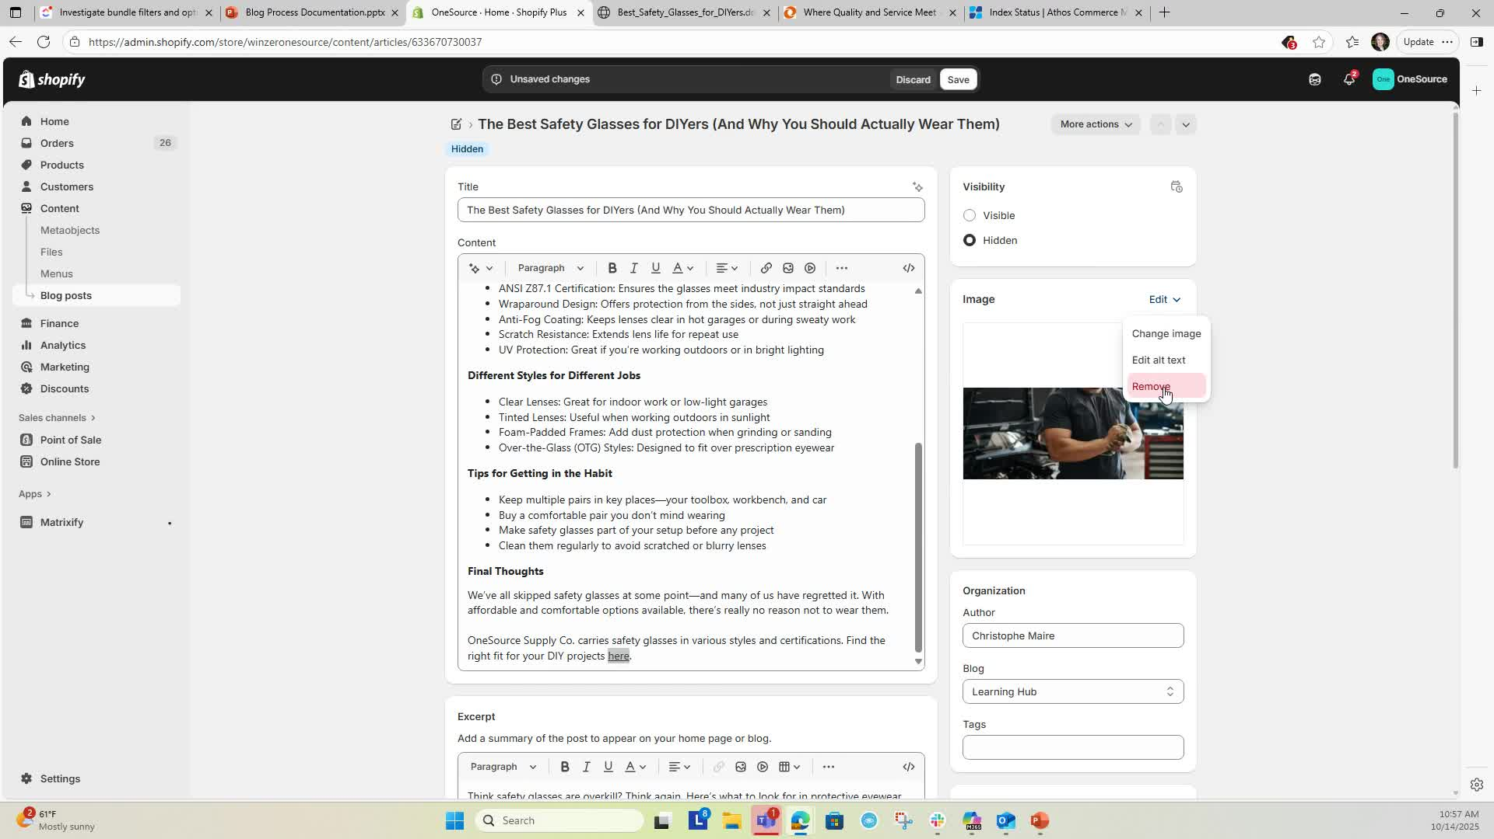
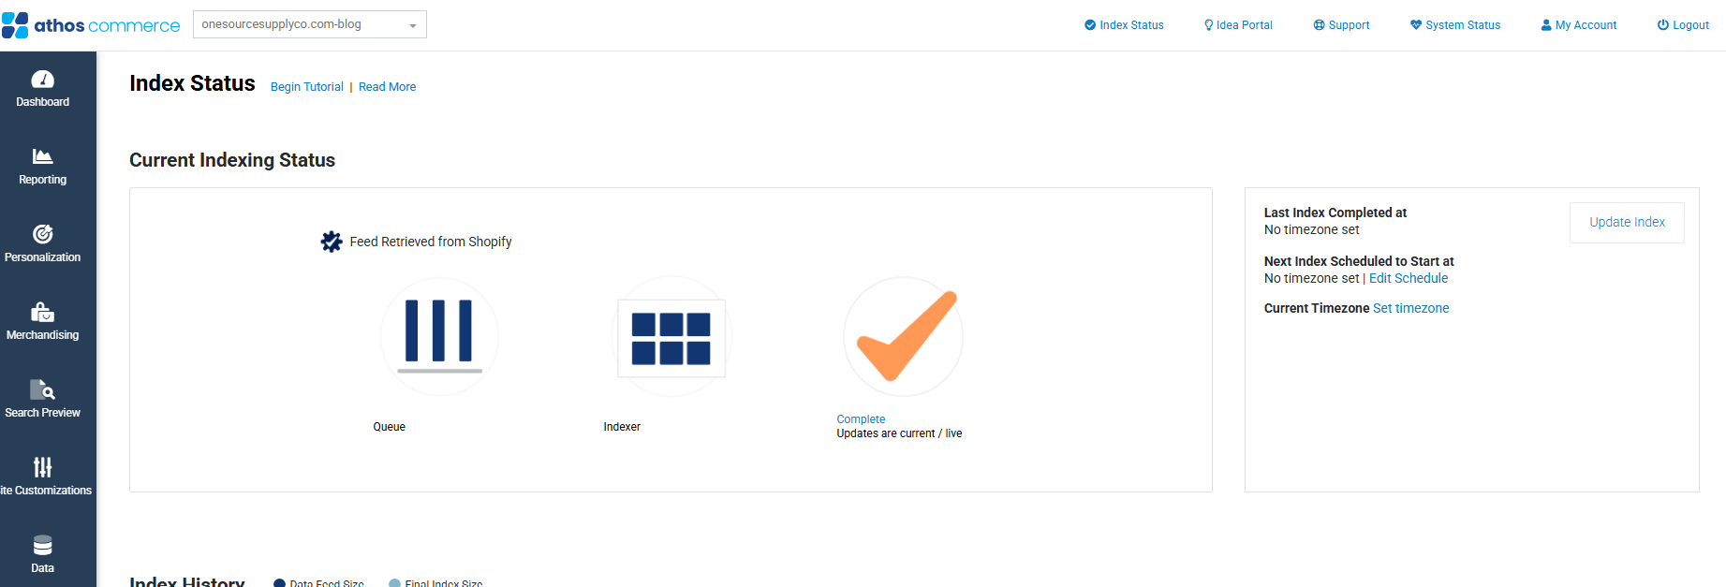
Shopify Blog Article Creation
Setting Visibility 4:03
Set the visibility of the article and choose a visibility date/time if needed
Go to Search Spring, select the blog, and hit Update Index to refresh the blog article on the live site
Updating Search Index 4:27

Slide 13
Shopify Blog Article Creation
Cautionary Notes
Ensure all links are functional before publishing
Double-check the image alt text to enhance accessibility
Cut and paste document into blog post as a starting point
Use AI tools for writing summaries and meta descriptions to save time
Keep a checklist of formatting requirements to ensure consistency across articles
Tips for Efficiency

